Slide 1
AAMDAANI

Slide 2
Introduction

Slide 3
What is “AAMDAANI”?
“AAMDAANI” is a simple and secure program that helps in recording basic day to day occuring monetary transactions. It helps in recording the transactions, with date and time, displays the overall transactions and helps in finding out the total spending or earnings from different fields.

Slide 4
OBJECTVIES
Encourage user in maintaining their monetary transaction.
Facilitate keeping all the records of incomes and expenses based on the with their date of occurrence.
Display the overall transactions based on categories, so as to help the user in planning the future expenses.
Make the user conscious about their spending habits and encourage on saving.

Slide 5
The
Program

Slide 6
ALGORITHM
Main function:
Step 1: Start
Step 2: call welcome()
Step 3: Input character c
Step 4: If c==’L’ or c==’l’
Call user()
Step 5: If (c==27) goto step 7
Step 6: Goto step 3
Step 7: End
User()
Step 1: Start
Step 2: Print “Only 3 attempts will be allowed to enter username and password

Slide 7
Step 3: Input username and password as user.name and user.password
Step 4: If cnt==2
Print “You have entered wrong username and/or password three times”
Print “Press enter to exit the program”
Goto step 10
Step 5: Read name and password from file “USER.DAT” as nam and pass.
Step 6: If user.name and nam and user.password and pass matches
c=1
Step 7: cnt=cnt + 1
Step 8: If c==1
Call main_menu()
Else
Print “Invalid username and/or password!”
Print “Press enter to try again”
Step 9: Goto step 4
Step 10: End

Slide 8
Main_menu()
Step 1: Start
Step 2: Print options
Step 3: Print “Press a choice between the ranges (1-5)”
Step 4: Switch (getch()-48)
Case 1: call rec_inc()
Case 2: call rec_exp()
Case 3: call display()
Case 4: call tran_delete()
Case 5: call tran_edit()
Case 6: Print “Are you sure you want to exit? <Y/N>”
If ex==’Y’ or ex==’y’
Goto step 5
Else call main_menu()
Default: Print "Your input is out of range! Enter a choice from 1 to 6!”
Print “Press any key to continue”
Step 5: End

Slide 9
FLOWCHART
Start
Print “Press L to Log in or Esc to Exit”
c=='L' || c=='l'
Yes
User()
C==Esc
Yes
End

Slide 10
Input username and password
Wrong username or password?
Yes
No
Main_menu()
A

Slide 11
A
Print choice
Print “Press a choice from the range [1-7]”
Switch(choice)
1
Call rec_inc()
2
Call rec_exp()
3
Call display()
4
Call tran_edit()
5
Call tran_delete()
6
Call edit()
default
7
End

Slide 12
Implementation

Slide 13
Control Statements
Control statements used in the program are:
If statement
Switch Statement
Header files
The header files used in the program are:
#include <stdio.h>
#include <stdlib.h>
#include <windows.h>
#include <conio.h>
#include <time.h>
#include <ctype.h>
#include <math.h>
Looping Statements
To perform repetitive processes, following looping statements used in the program:
While loop
For loop

Slide 14
User Defined Functions
The user defined functions has been divided into 3 categories, they are:
1. Main Functions: These functions forms the main structure of the program.
user(): Window to login to enter main menu of the program
main_menu(): Main menu of the program
rec_inc(): To record transaction regardina income
rec_exp(): To recored transaction regarding expenditure
display(): To display overall transaction
tran_delete(): To delete transaction
tran_edit(): To edit transaction
edit(): To edit username and password

Slide 15
2. Sub Functions:
These functions are the later parts of main functions which helps in operating the main functions.
disp_main(int): Main function to display transaction
tran_main_inc(int): Main function to record income transaction
tran_main_exp(int): Main function to record expense transaction
2. Miscellaneous Functions: These functions are the small visual and building blocks of the program.
gotoxy(int x,int y)
_password(char buffer[])
rectangle(int x,int y,int l,int b)
currency(char cur[], float n
date_output(char date[])
welcome()
title()

Slide 16
Input/Output

Slide 17
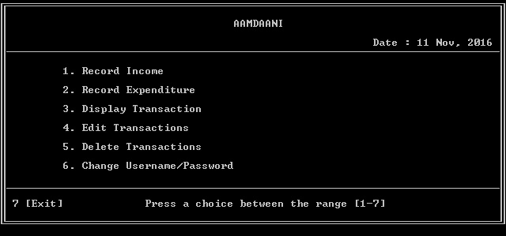
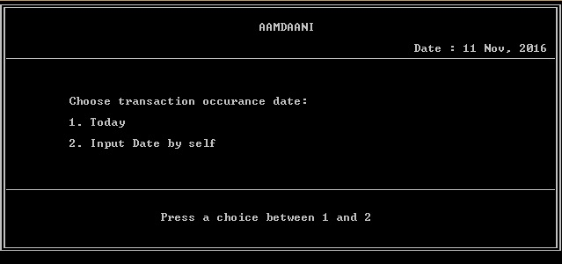
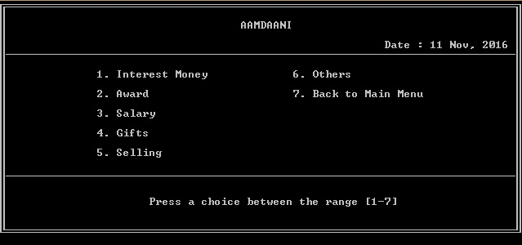
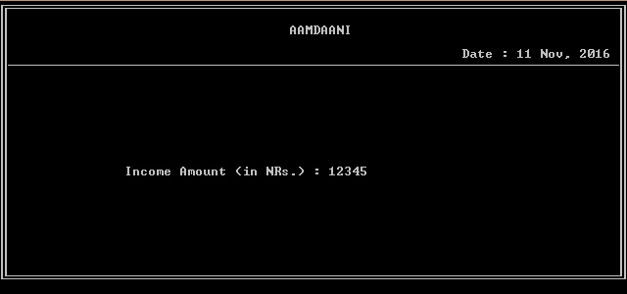
Recording Transaction
1.
3.
2.
4.

Slide 18
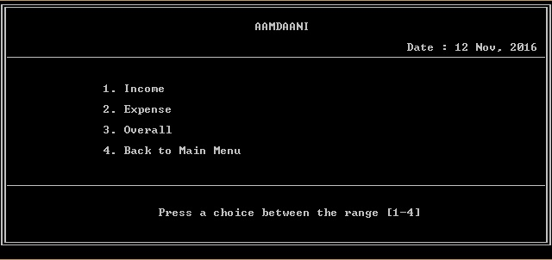
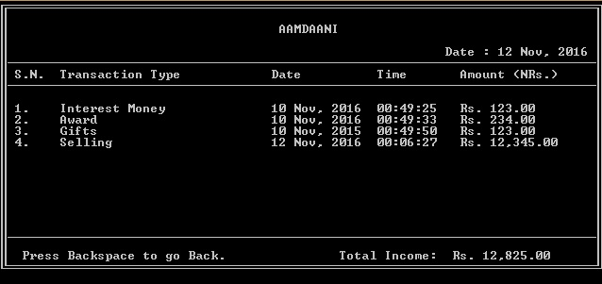
Displaying Transaction
1.
2.
3.

Slide 19
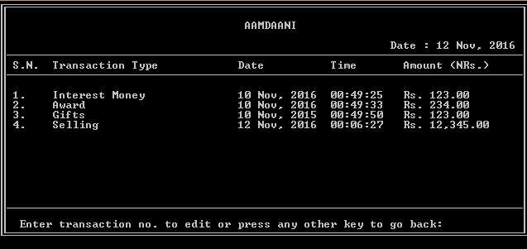
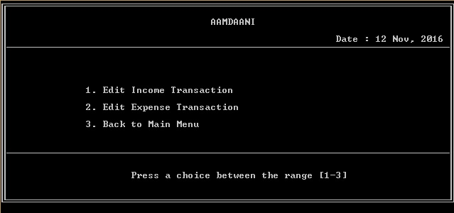
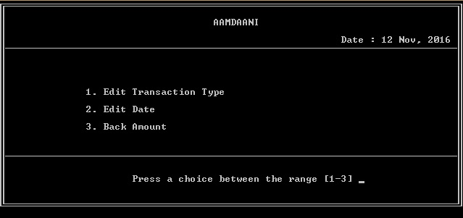
Editing Transaction
1.
3.
2.
4.

Slide 20
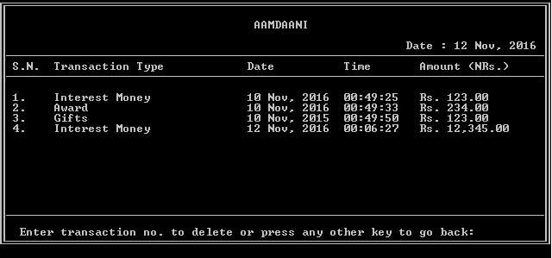
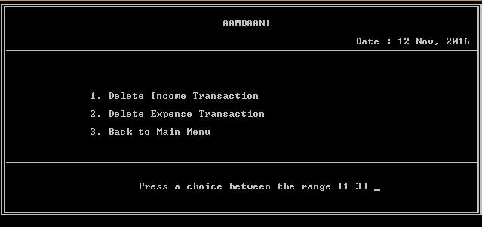
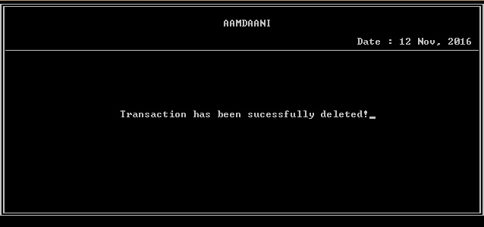
Deleting Transaction
1.
3.
2.
4.

Slide 21
CONCLUSION
AAMDAANI is a simple program that records basic monetary transactions.
Helpful to perform paperless work and manage all data.
Provides easy, accurate, unambiguous and faster data access.

Slide 22
LIMITATIONS
Transactions are executed in off-line mode.
Off-line information cannot be generated.
The existing system only provides text-based interface, which is not as user-friendly as Graphical user Interface.
Initial username and password is premade, hence user need it enter it and then only user can personalize the system.
The records are not recorded according to date.

Slide 23
Thank
You

